Slide 1
BASIC JAPANESE LANGUAGE
GLT1031 (WEEK 5)

Slide 2
PREVIOUS CONTENTS
About topic : | To give a simple self introduction
Grammar : | Tell your name Talk about occupation Talk about nationality Talk about ability to speak what language Particle も and と

Slide 3
復習しましょう・ふくしゅうしましょう
G1
おなまえはなんですか？
G2
おしごとはなんですか
G3
しゅっしんはなんですか
G4
マレーごができますか

Slide 4


04
かぞくのしょうかい
Introducing the family

Slide 5
CONTENTS OF THIS LESSON
About topic : | To talk briefly about your family
Grammar : | A. Mention how many family member do you have B. Who are they (particle と) Information about your family member (name, age, occupation, nationality) Mention where they lives

Slide 6
GRAMMAR PART
① わたしのかぞく・かぞくは＿＿＿です
watshi no Kazoku・Kazoku wa _____ desu
Basic sentence :
      わたし の かぞく は さんにん です
      watashi no kazoku wa san‘nin desu
      There are 3 people in my family
Structure :
① A. Mention how many family member
do you have
わたしのかぞく – my family
N1 | は | N2 | です
N1 | は | なんにん | ですか

Slide 7
NUMBERS & COUNTERS
Link for counting numbers in Japanese :
https://www.tofugu.com/japanese/counting-in-japanese/
Link for numbers & basic counters :
https://www.tofugu.com/japanese-grammar/numbers-and-counters/
Link for other counters :
https://www.tofugu.com/japanese/japanese-counters-list/

Slide 8
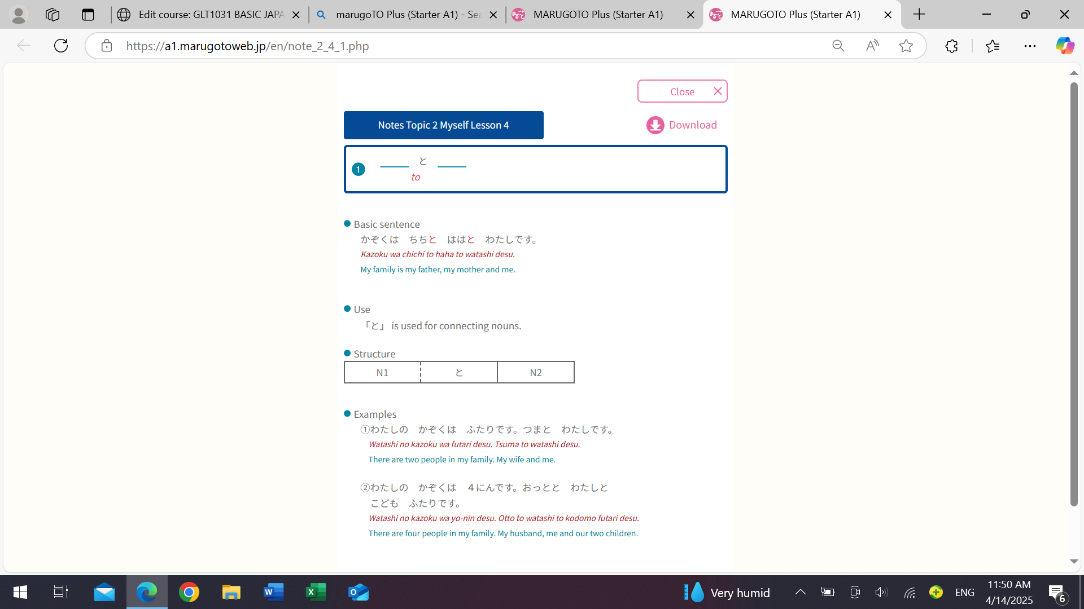
GRAMMAR PART
① B. Who are they
*Family member’s term
Own family member
Someone else family member

Slide 9
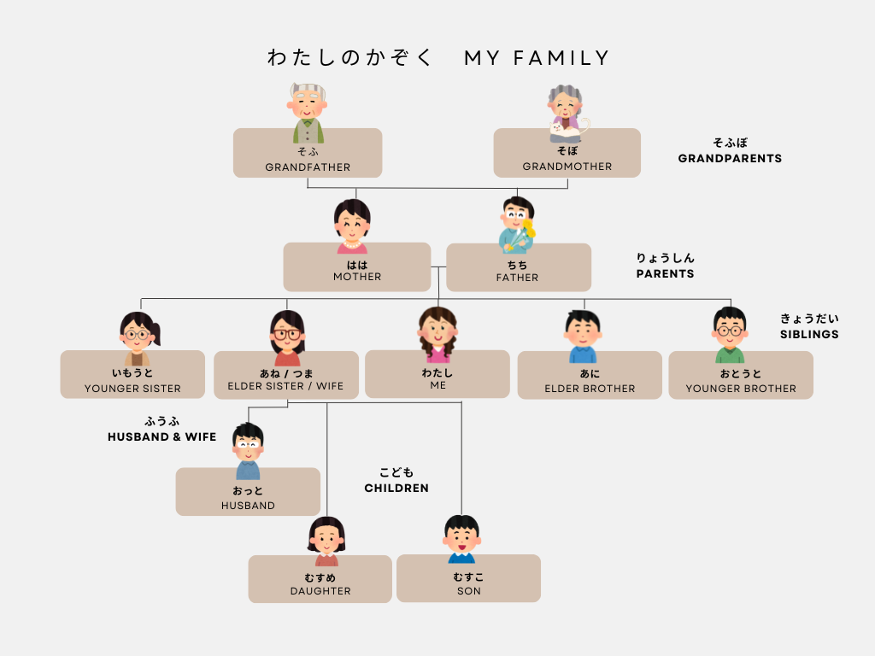
sofu
sobo
haha
chichi
imooto
ane
tsuma
ani
otooto
otto
かけいず・家系図
Family Tree

Slide 10
おじ= uncle | おば = aunty
おい = nephew | めい = niece
いとこ = male/female cousin
ちょうじょ= First-born daughter じじょ = Second-born daughter さんじょ = Third-born daughter
ちょうなん = First-born son じなん = Second-born son さんなん = Third-born son
ぎりの～ = ~in law

Slide 11
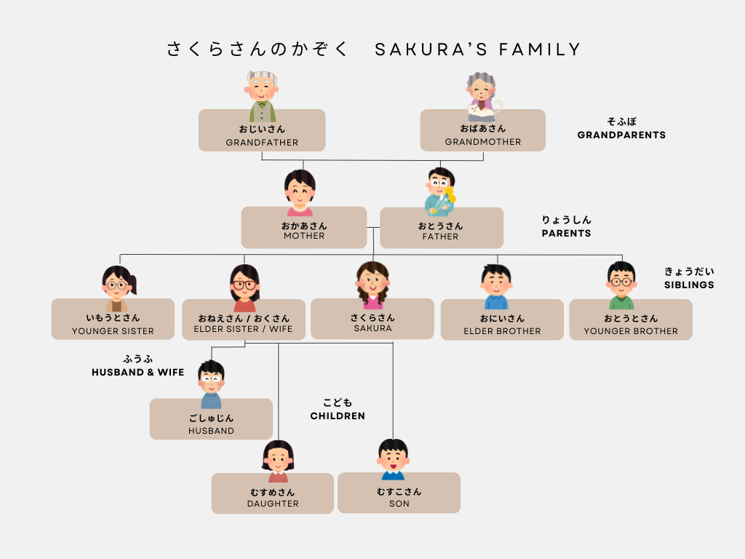

Slide 13
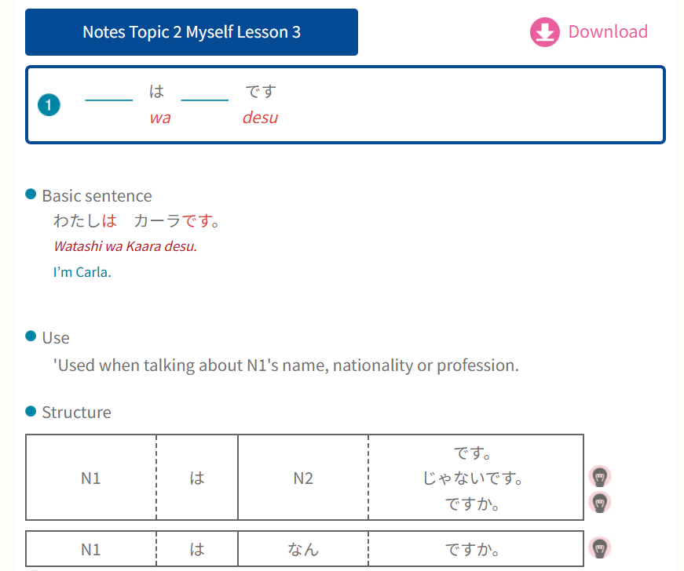
GRAMMAR PART
② Information about your family
member (name, age, occupation,
nationality)

Slide 14
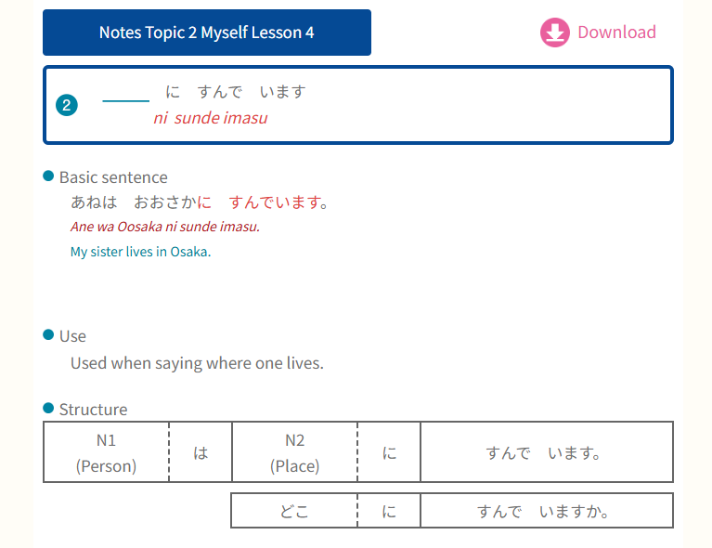
GRAMMAR PART
③ Mention where they live
すんでいます – living (to live)

Slide 15
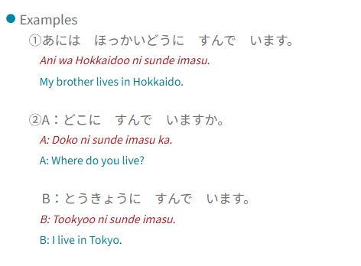

Slide 16
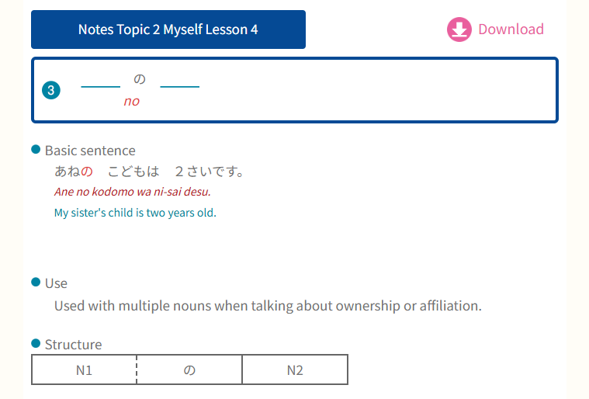
GRAMMAR PART
④ Particle の
Used to connect two nouns
(cannot connect verbs/adjectives)
N1 modifies/describe N2.
N2 is the main point
N1 is extra point

Slide 17
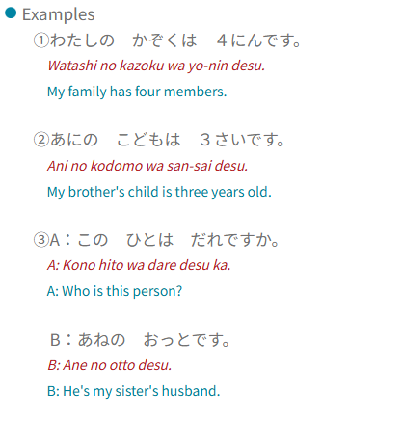

Slide 18


